Slide 1

EP-COT
SIMULATIONS
Nihar Shah
Yash Bachwana

Slide 2
TABLE OF CONTENTS
01.
02.
03.
THE DESIGN
HEAT TRANSFER
ELECTRICAL
04.
05.
06.
STRUCTURE
AIR FLOW
EVAPORATIVE COOLING

Slide 3

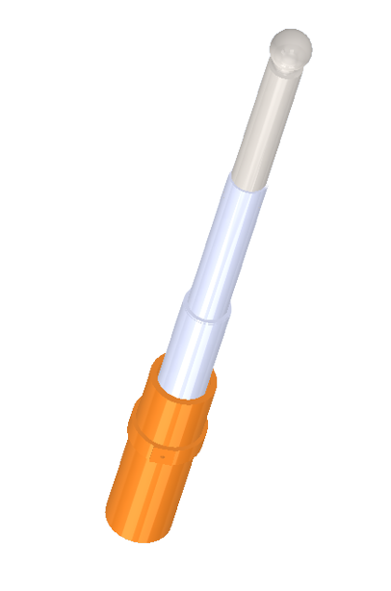
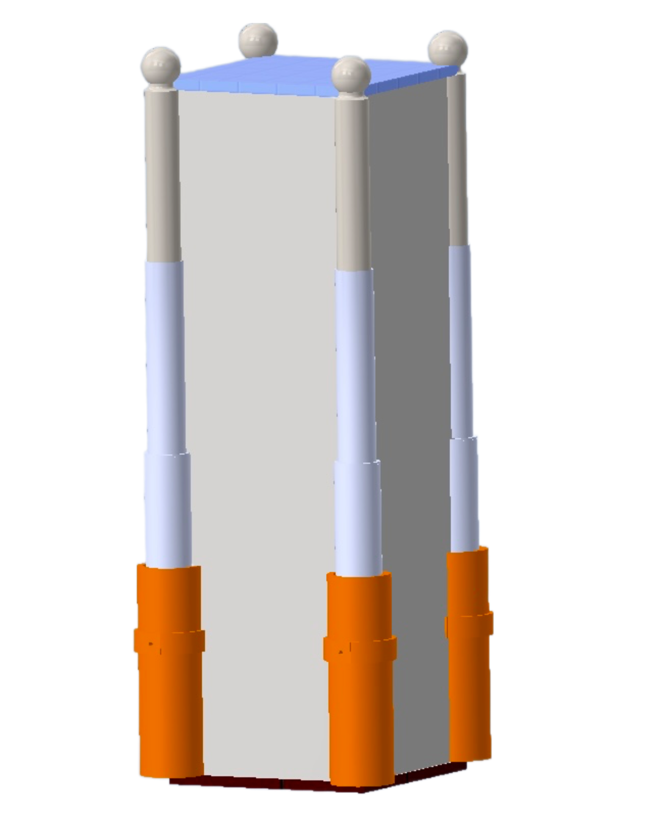
01.
THE DESIGN
Telescopic poles
Reservoir
Base

Slide 4
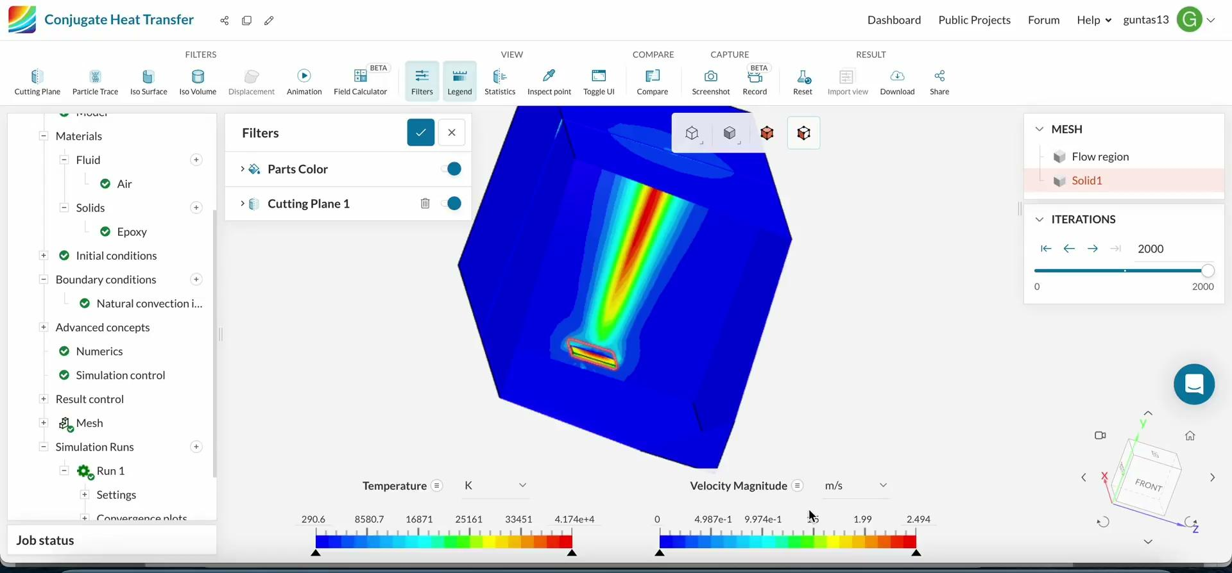
02.
HEAT TRANSFER
Notes:
All the parameters have been carefully assigned to the simulation after taking into account the type of conditions we get around ourselves, this simulation shows that our prototype will be able to transfer heat outside and regulate a relatively cooler environment inside the enclosure which will therefore help the user.

Slide 5
We placed a thin sheet of 6.25mm x 6mm in a 60mm x 30mm x 60mm enclosure (these dimensions are scaled).
For the heat transfer simulation:
i) the sheet material was chosen as epoxy
ii) air was the convection medium
iii) the gravity was set
iv) the power source was chosen as 150W
The simulation shows the variation of temperature when a peltier-like cooler/heater is placed in the enclosure.
The colour bands in the illustration above show the temperature range along with the velocity of the air getting inside due to the peltier mechanism.
It can be clearly seen that the velocity is maximum in the middle region and the temperature of the environment decreases as time increases. Also, the peltier cooler starts to heat up because of which we brought heat sink into use.

Slide 6

03.
ELECTRICAL SIMULATION
Notes:
All the parameters have been carefully assigned to the simulation after taking into account the type of conditions we get around ourselves, this simulation shows that our prototype will be able to transfer heat outside and regulate a relatively cooler environment inside the enclosure which will therefore help the user.

Slide 7
In the simulation of electrical components above , the 4 peltier coolers are depicted by 4 green LEDs and the 4 DC fans are depicted by 4 red LEDs.
The inner and outer temperatures are the 2 data values for our DHT11 Sensor (not available on TinkerCad so had to show separately). Whenever the temperature difference is above 10 degree celsius or the temperature inside is above 28°C, the peltier cooler will turn on and when the temperature difference is below 10°C, it will turn off taking into consideration the ambient difference in temperatures is safe for prevention from heat stroke (a feature not in ACs).
When the humidity level goes above 50% (the researches show that RH level above 50% is the cause for humidity related heat), the DC fans turn on driving the humid air out and restoring back to initial condition (Covering the disadvantages of Air coolers and making it multi-dimensional).

Slide 8
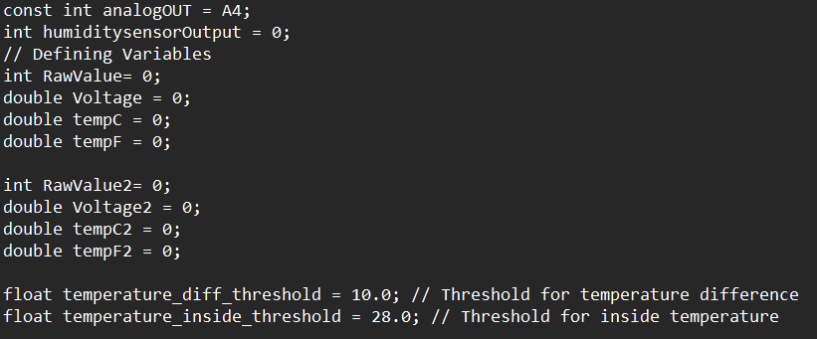
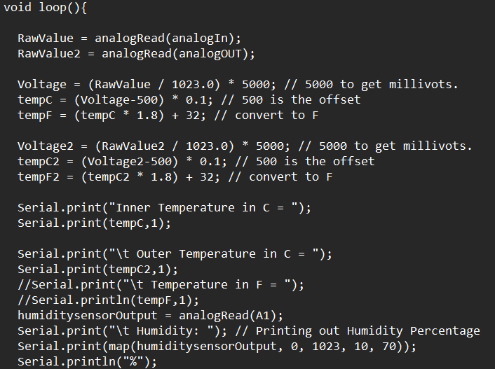
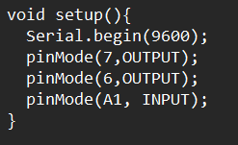
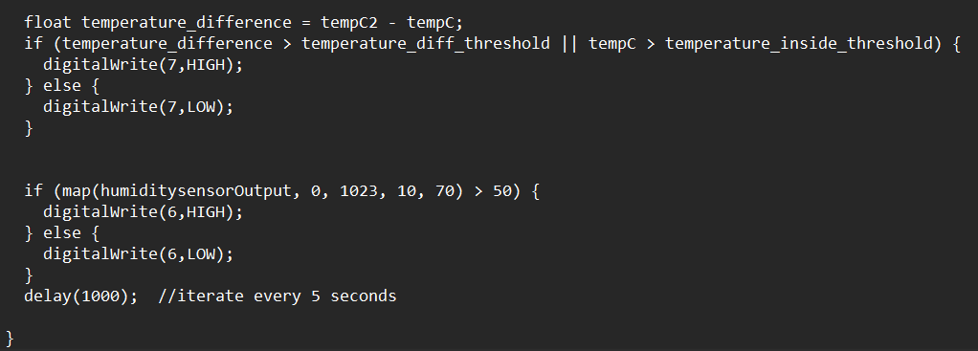
SAMPLE CODE
Defining The variables
Using the Input Values
Inputs/Outputs
Conditions for working of fan/peltier mechanism.

Slide 9
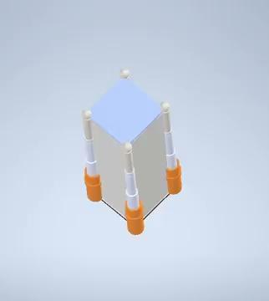
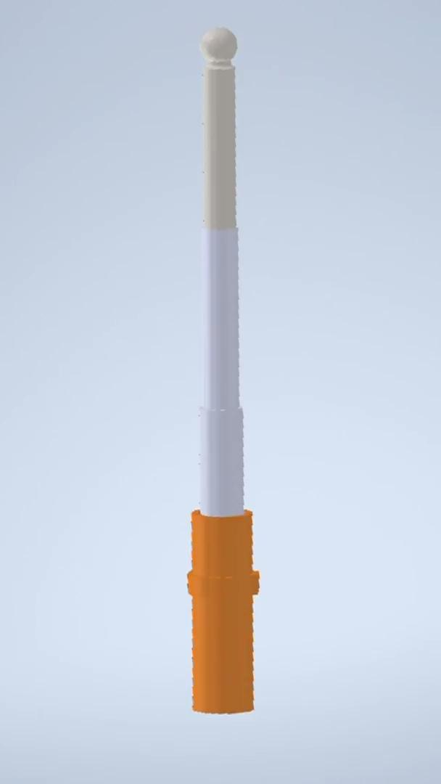
04.
STRUCTURE SIMULATION
Exploded view of tent
Working of telescopic poles

Slide 10
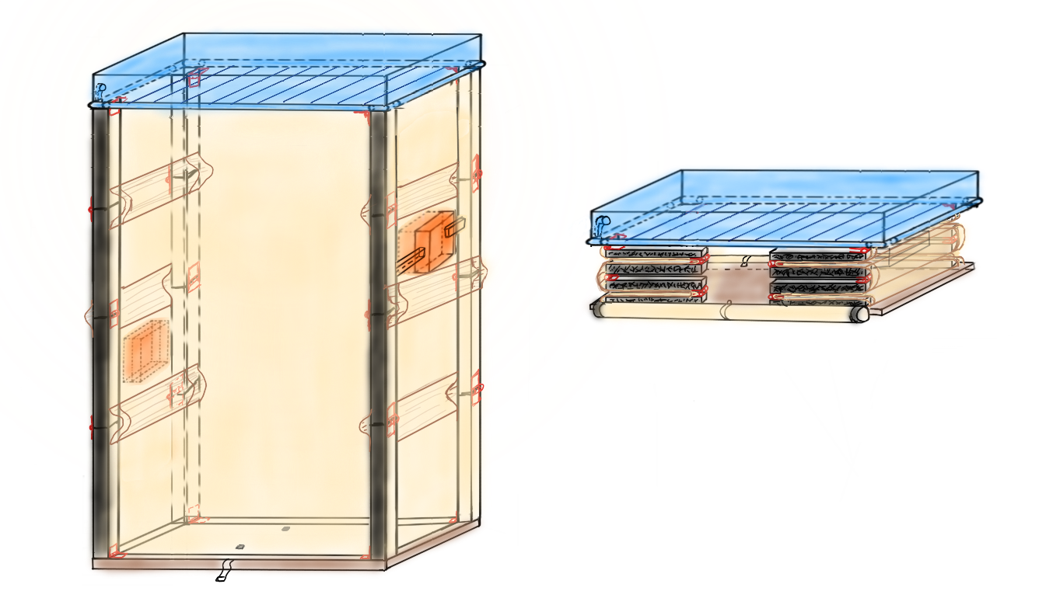
PROPOSED STRUCTURE

Slide 11
05.
AIR-FLOW SIMULATION
Notes:
The Air flow simulation has been created to show that the surfaces of the tent has been used as a form of air transfer along with other things such as the peltier coolers and the reservoir which will ultimately enhance the temperature difference, in this approch each and every value of the parameters have been assigned keeping in mind the type of environment we are trying to use this product for.

Slide 12
Air Flow Simulation: Again with the same dimensions, two openings were made at the same height level that acted as velocity intakes with 15 m/s as the velocity influx.
Small openings in the top and bottom were kept to allow for pressure outtake.
Simulation showed the pressure variation in the tent, velocity variation setup was wrongfully placed within the extrusion of the material.
Another simulation was run parallel on another PC with the openings (mimicking like the evaporative fans) placed at two different height levels.
The simulations require several parameters to be tuned- velocity intake, pressure outtake, the values of the velocity influxes, power source wattage and more.
It takes around half an hour to an hour to simulate the entire model.

Slide 13
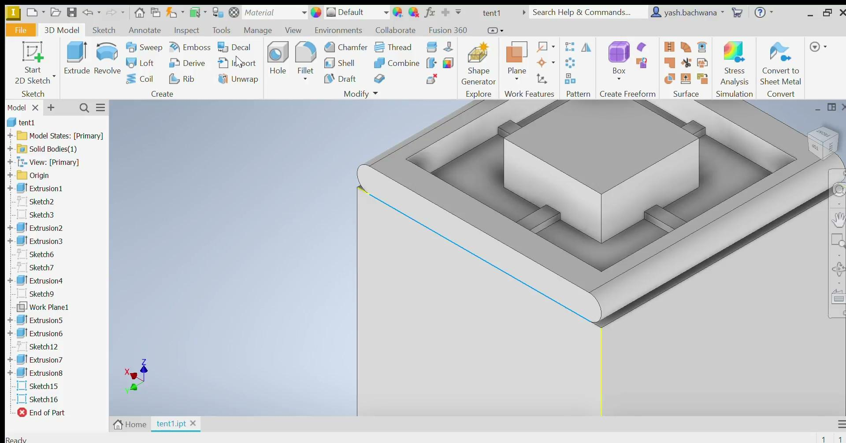
06.
EVAPORATIVE COOLING SIMULATION

Slide 14
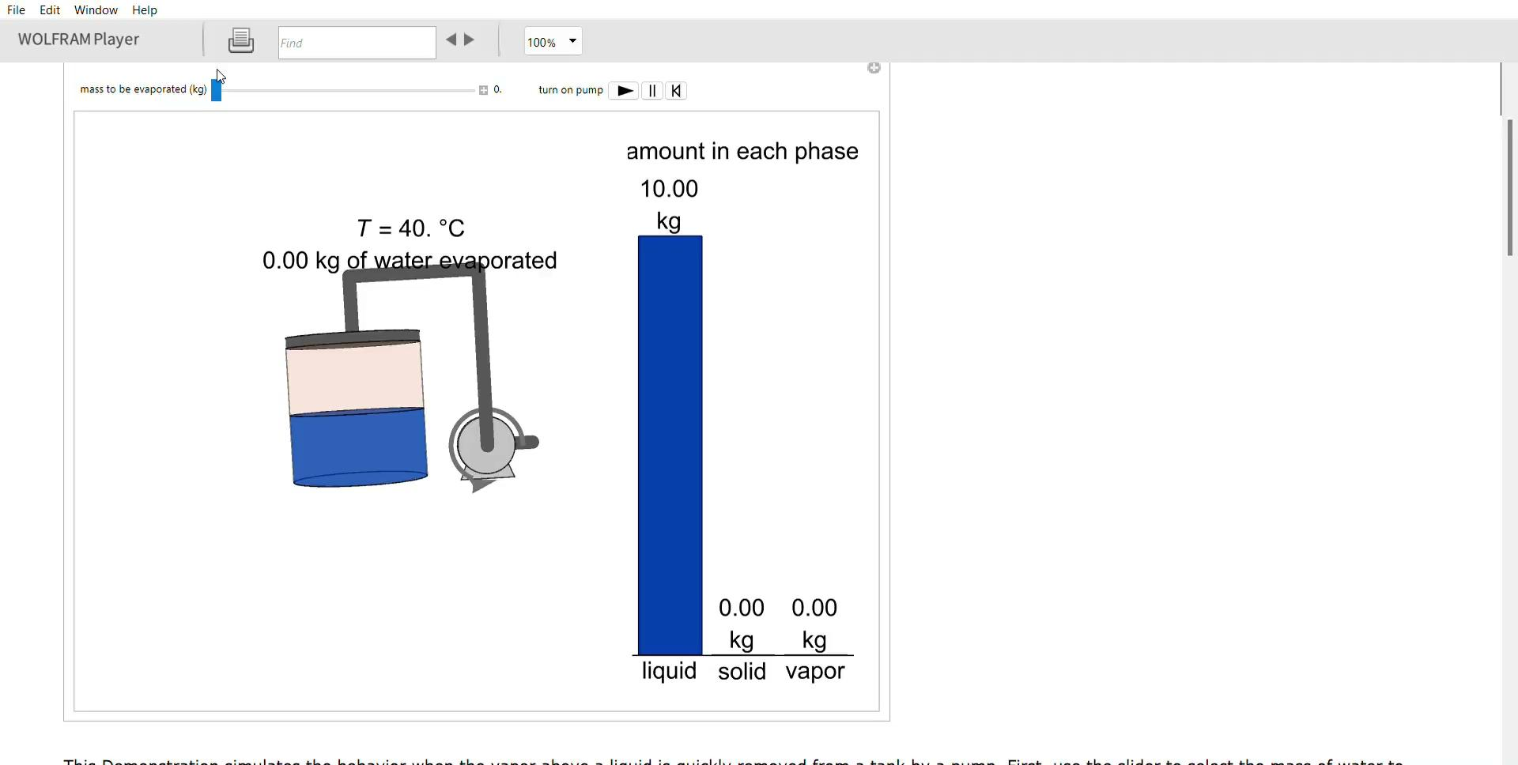

Slide 15
Simulation of water storage and drenching mechanism :
According to our plan during conceptualization, we were to keep a water storage reservoir on the top of the tent, which lets water flow through the pipe along the circumference of the top.
Water from the pipe falls on the fabric through small pores on the pipe.
We have also demonstrated how many litres (1Kg = 1 L of water) would be needed to increase the temperature by 1 degree celsius (approximately 100ml).
To demonstrate the process with clarity, we tried to simulate many processes using an online website simScale, which imports .ipt files and allows us to visualize the flow of water and air, by specifying a few parameters. Due to certain technical constraints, we could not replicate this part of the tent on an autocad model.

Slide 16

LET'S BEAT
THE HEAT
THIS SUMMER!

Slide 17
THANK YOU

